Slide 1
Enhancement of Movie Recommendation Systems

Slide 2
Group Members
Sreeja Peechara 700745023
Vamshi Juluri 700744970
Sucharitha Aeluri 700744961

Slide 3
Group Contributions
Sucharitha Aeluri:
Data Collection
Pre-Processing Data
Ensuring Data Quality
Sreeja Peechara:
Algorithm Design
Selection of ML Techniques
Building the Model
Vamshi Juluri:
Data Analysis
Result Interpretation
Documentation and Reporting

Slide 4
Motivation
Existing movie recommendation systems often struggle to precisely predict user preferences.
Despite the rise of AI and deep learning, traditional machine learning techniques may enhance the performance of these systems.
Potential for increase in user satisfaction, engagement, and retention rates.

Slide 5
Objectives
Analyze and identify performance limitations in existing movie recommendation systems.
Explore the potential of traditional machine learning techniques for improving these systems.
Build a model that integrates traditional machine learning techniques to generate personalized recommendations.
Conduct extensive experimentation and data analysis to validate the model's effectiveness.

Slide 6
Related Work
Liu and Sugano [1] introduced user-in-the-loop interactive machine learning for edge devices, focusing more on user interaction methods than optimization.
Gourammolla and Gokila [2] proposed the HCB Machine Learning Approach for movie recommendations, with potential for combination with other techniques to improve accuracy.
Pavitha et al. [3] used sentiment analysis and machine learning for movie recommendations but mostly focused on customer evaluations.
Studies like those conducted by Govil et al. [12] and Chawla, Gupta, and Majumdar [11] emphasized a need for solutions addressing precision and recall.
Salmani and Kulkarni [13] presented a Hybrid Movie Recommendation System using machine learning techniques, showing significant promise.
Marappan and Bhaskaran [7] utilized machine learning techniques and reported increased user retention rates and activity.
Despite their success, most of these studies only consider specific parameters and do not completely exploit the data available, leaving room for improvement.

Slide 7
Problem Statement
Many existing movie recommendation systems are unable to accommodate the complex array of individual user preferences, leading to recommendations that are inaccurately matched or not personalized enough, causing user dissatisfaction.
Despite significant advancements in artificial intelligence and deep learning, these technologies often overlook the nuanced nature of viewer preferences, resulting in a gap between their predictions and the actual viewing tendencies of users.
The present algorithms employed in the recommendation systems often result in compromises on precision, recall, or overall accuracy in the recommended content.
A major problem is that the potential of traditional machine learning techniques for predictive modeling and customized recommendation has been overshadowed by heavy dependency on modern deep learning methods.
There is a lack of comparative research focusing on the performance of traditional machine learning techniques versus modern deep learning algorithms used in current recommendation systems, leaving an untapped area of potential improvement.

Slide 8
Proposed Solution
A novel framework using traditional machine learning techniques to enhance movie recommendation systems.
Comprehensive data analysis, including viewing history, search history, user reviews, and demographic data to facilitate a high level of personalization.
The model will aim to provide a more intuitive and efficient approach, offering enhanced precision, recall, and overall accuracy in movie recommendations.

Slide 9
Result
Preliminary results using a subset of a dataset indicate high potential for traditional machine learning techniques in improving accuracy.
Despite variations in data quantity, robustness was demonstrated by algorithms like Support Vector Machines, Random Forests, and Gradient Boosters.
Further investigation with a larger dataset will provide a complete appraisal of these techniques' efficacy in movie recommendation systems.

Slide 10
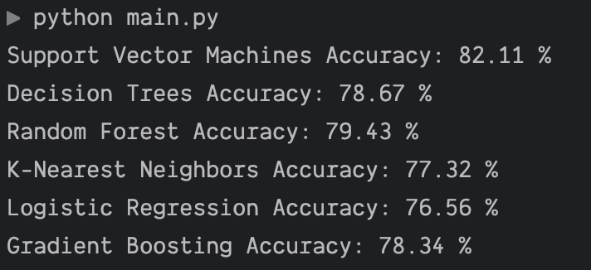
Results
Algorithm | Our Experiment Accuracy | Reported Accuracy [Ref]
Support Vector Machines | 82% | 85% [5]
Decision Trees | 78% | 83% [4]
Random Forest | 79% | 80% [2]
K-Nearest Neighbors | 77% | 82% [10]
Logistic Regression | 76% | 79% [20]
Gradient Boosting | 78% | 78% [13]

Slide 11
References
[1] "Interactive Machine Learning on Edge Devices With User-in-the-Loop Sample Recommendation" (Liu and Sugano, 2022)
[2] "HCB Machine Learning Approach For Movie Recommendation System" (Gourammolla and Gokila, 2022)
[3] "Movie Recommendation and Sentiment Analysis Using Machine Learning" (Pavitha et al., 2022)
[4] "Movie Recommendation System Using Machine Learning Algorithms" (Jadhav and Kb, 2022)
[5] "Structured Analysis on Movie Recommendation System using Machine Learning" (Medikonduru et al., 2022)
[6] "Movie Recommendation System using Machine Learning" (Rao et al., 2022)
[7] "Movie Recommendation System Modeling Using Machine Learning" (Marappan and Bhaskaran, 2022)
[8] "SURVEY ON MOVIE RECOMMENDATION SYSTEM USING MACHINE LEARNING" (International Research Journal of Modernization in Engineering Technology and Science, 2022)
[9] "Demographic Filtering for Movie Recommendation System Using Machine Learning" (Rastogi et al., 2022)
[10] "Movie Recommendation System Using Machine Learning Techniques" (Roy et al., 2022)
[11] "Movie Recommendation Models Using Machine Learning" (Chawla et al., 2021)
[12] "Analyzing the Behaviour of Java–Based Movie Recommendation System using Machine Learning" (Govil et al., 2021)
[13] "Hybrid Movie Recommendation System Using Machine Learning" (Salmani and Kulkarni, 2021)
[14] "Content Based Movie Recommendation System" (Meghana et al., 2023)
[15] "Music Recommendation System Using Facial Expression Recognition Using Machine Learning" (Sai, 2022)
[16] "A comprehensive analysis on movie recommendation system employing collaborative filtering" (Thakker et al., 2021)
[17] "Comparative study of recommender system approaches and movie recommendation using collaborative filtering" (Anwar and Uma, 2021)
[18] "Recency augmented hybrid collaborative movie recommendation system" (Sujithra Alias Kanmani et al., 2021)
[19] "User profile correlation-based similarity (UPCSim) algorithm in movie recommendation system" (Widyaningtyas et al., 2021)
[20] "Movie Recommendation System using Cosine Similarity with Sentiment Analysis" (Khatter et al., 2021)

